Slide 1
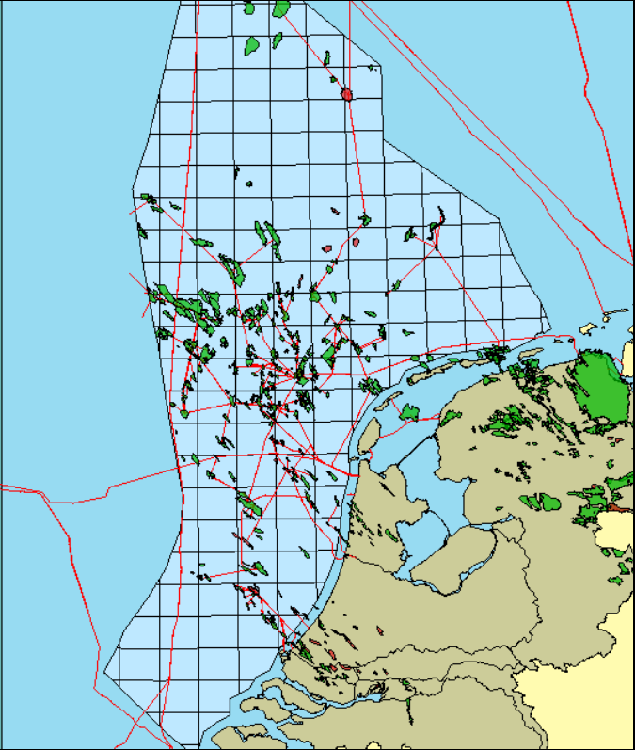
CO₂ storage options and CCS development in The Netherlands
Filip Neele*, Vincent Vandeweijer
TNO, The Netherlands; * filip.neele@tno.nl
June 2017
Storage capacity in The Netherlands (2017)
Depleted gas fields offshore | Effective | 1000 Mt | In clusters
 | Practical | 100 Mt | Assessed in some detail
 | Matched | 8 Mt | Storage license
Saline formations offshore | Theoretical | 1500+ Mt
 | Effective | 200 Mt | Assessed in some detail
200 km
500 km
Eemshaven
CCS In The Netherlands
2004 – 2014: CATO programme – national CO₂ capture, transport and storage R&D programme, budget M€ 60. Programme topics cover technical, regulatory and public awareness. The programme supports the development of the ROAD project.
2004 – 2011: Several onshore storage options explored, until under influence of public opinion onshore storage is delayed, until geological storage of CO₂ is sufficiently demonstrated in offshore reservoirs.
2004: Start of re-injection of CO₂ in the offshore K12-B field by operator ENGIE. By 2016, about 100 kt has been re-injected, to study the behaviour of CO₂ in the reservoir.
2009: Start of development of the ROAD project– CO₂ capture from new coal-fired power plant in the Rotterdam harbour, with storage in an offshore depleted gas field. Capture target is 1.1 Mtpa. The project currently awaits FID.
2009: London Protocol signed by The Netherlands.
2010: National CO₂ transport and storage roadmap, set up by prospective national transport and storage coordinators.
2010: The onshore storage project in Barendrecht cancelled due to public opposition.
Rotterdam area
Map of high-capacity offshore storage options in The Netherlands. Green circles: (clusters of) depleted gas fields; blue circles: saline formations; Yellow circles: large source areas (Neele, et al. 2012).
2011-12: Updated the CO₂ storage feasibility assessment of several offshore gas fields and saline formations. The storage capacity of clustered gas fields is about 1000 Mt, of saline formations at least 1500 Mt .
2013: First CO₂ storage permit under EU CCS Directive assigned to the P18-4 offshore gas field (storage capacity about 8 Mt).
2017: CCS is high on government and industry agenda.
The CO₂ transport and storage plan is being updated.
Detailed technical studies performed to decarbonise the Rotterdam harbour.
An application for an offshore CO₂ transport pipeline structure submitted to receive EU funding.
The Port of Rotterdam develops plans to extend the CO₂ collection network and increase CO₂ deliveries to greenhouses.
Other initiatives have started to connect CO₂ supply with CO₂ re-use opportunities.
Netherlands co-chairs working group to establish road map to meet emission reduction targets.
CCS projects The Netherlands |  |  | Start | CO₂ volume
Pilot projects | K12-B offshore gas field | Re-injection of separated CO₂ | 2004 - present | 100 kt, cumulative
Demo projects | ROAD | Storage in depleted gas field | Awaiting FID | 1.1 Mtpa
Key references
1. EBN-Gasunie, 2010, CO2 transport en opslagstrategie (in Dutch; CO2 transport and storage strategy), https://www.ebn.nl/wp-content/uploads/2016/12/co2_transport_en_opslagstrategie_ebn_gasunie.pdf
2. Neele, F, Hofstee, C, Dillen, M and Nepveu, M, Independent storage assessment of offshore CO2 storage options for Rotterdam: Summary report, TNO report TNO-060-UT-2011-00809, TNO, The Netherlands, 2011, www.globalccsinstitute.com/publications/independent-storage-assessment-offshore-co2-storage-options-rotterdam-summary-report.
3. Neele, F., ten Veen, J., Wilschut, F. and C. Hofstee, Independent assessment of high-capacity offshore CO2 storage options, TNO report TNO-060-UT-2012-00414/B, 2012, (http://www.globalccsinstitute.com/publications/independent-assessment-high-capacity-offshore-co2-storage-options).
4. Kopp, A., Ros, M., Jonker, T., Wevers J.-P., Gittins, C., Plug, W.-J., Aspects of the storage permit application for CO2 storage in the depleted gas field offshore the Netherlands, Energy Procedia, 37, 2013, Pages 6287-6294, https://doi.org/10.1016/j.egypro.2013.06.557.
5. Steeghs, P., Neele, F., Gittins, C. and Ros, M., Drafting a monitoring plan for the ROAD project under the EU CCS Directive. Energy Procedia, 63, 2014, 6680-6687, http://dx.doi.org/10.1016/j.egypro.2014.11.702.
6. Nepveu, M., Neele, F., Delprat-Jannaud, F., et al., CO2 storage feasibility: a workflow for site characterisation, Oil and Gas Science and Technology, 70, 555-566, 2015, http://dx.doi.org/10.2516/ogst/2014034.

